Slide 1

RESEARCH PRESENTATION
PRESENTED BY
Pranika, Varun, Mihir
Evaluation and Recommendation Framework for LLMs
COURSE
CS 671
Notes:
Today, we're introducing a robust framework for evaluating and recommending Large Language Models, focusing on something often overlooked: the quality of their reasoning. We'll explore how to move beyond just correct answers to truly understand an LLM's underlying logic. This framework is crucial for deploying LLMs responsibly, especially in high-stakes environments. Let's dive into why this distinction matters so much. ____________OR______ Today we’re presenting a framework for evaluating and recommending large language models. Most existing evaluations focus only on whether a model gives the correct answer. But in real-world use, especially in domains like healthcare or legal systems, correctness alone is not enough. The reasoning process matters just as much. Our work focuses on analyzing that reasoning, not just the final output, and building a system that can evaluate models based on how they think, not just what they say.

Slide 2

Motivation and Context
The Problem
The Rashomon Effect
LLMs are used in high-stakes domains (Medical, Legal) where the "how" matters as much as the "what."
•
Models reach the same correct answer via conflicting or flawed reasoning paths.
•
A correct answer from flawed logic is a liability, not an asset.
•
Current evaluations focus on final answer accuracy, ignoring the logical path.
•
Notes:
We call this challenge the "Rashomon Effect" in LLMs, inspired by Akira Kurosawa's classic film. Just as characters in the film offer conflicting accounts, LLMs can reach correct answers through flawed reasoning. This is a critical blind spot in standard benchmarks, which often only assess the final output. For fields like medicine or law, we can't overlook flawed reasoning, even if the final answer appears correct. This brings us to the core of our evaluation strategy.

Slide 3
Research/project question
How can we quantitatively evaluate and verify the alignment of LLM reasoning paths with established logical standards?
Can we detect the Rashomon Effect where models get the right answer for the wrong reasons?
→
Is it possible to create a pluggable framework that ranks models based on reasoning integrity?
→
How do we balance reasoning depth with computational and API cost efficiency?
→
Notes:
This leads us to our central research question: How can we quantitatively evaluate and verify the alignment of LLM reasoning paths with established logical standards? We aim to detect the Rashomon Effect, where models get the right answer for the wrong reasons. Our goal is to create a pluggable framework that ranks models based on reasoning integrity. Ultimately, we want to balance reasoning depth with computational and API cost efficiency. This framework will help us answer these critical questions, and we'll see how in our methodology.

Slide 4

Core Evaluation Metrics (Part 1)
Metric
Measures
Formula / Approach
KEY INSIGHT
AAS (Answer Alignment)
Is the final answer correct?
cosine_sim(model_ans, gold_ans)
RAS is the Rashomon metric—it reveals when two models reach the same answer via different reasoning paths, exposing flawed logic.
RAS (Reasoning Alignment)
Does reasoning match golden reference?
cosine_sim(model_reas, gold_reas)
SLMS (Step-Level Matching)
Does model cover all golden steps?
Asymmetric step-by-step matching
Notes:
To address the Rashomon Effect, we've developed a suite of core evaluation metrics, starting with Answer Alignment Score, or AAS, which measures if the final answer is correct. But the real innovation lies in Reasoning Alignment Score, or RAS. RAS directly quantifies how well an LLM's reasoning matches a golden reference, exposing instances where a correct answer might mask poor logic. This is our Rashomon metric; it's designed to reveal those divergent reasoning paths. And then we have Step-Level Matching, or SLMS, which checks if the model covers all necessary steps in its reasoning. These metrics collectively provide a much deeper understanding of an LLM's performance than just looking at the final answer. Now, let's look at some additional metrics that round out our framework.

Slide 5

Core Evaluation Metrics (Part 2)
Metric
Measures
Formula / Approach
CS (Consistency Score)
Stability of reasoning across runs
1 − variance(RAS₁, ..., RASₜ)
DKUS (Domain Knowledge)
Utilization of domain concepts
Concept overlap / Golden concepts
FPS: Final Preference Score
FPS = w₁·AAS + w₂·RAS + w₃·SLMS + w₄·CS + w₅·DKUS
Weights are configurable in real-time — adjust on-the-fly based on application priorities (e.g., Medical vs. Tutoring).
Notes:
Building on our core metrics, we also incorporate Consistency Score, or CS, which assesses the stability of an LLM's reasoning across multiple runs. We also include Domain Knowledge Utilization Score, or DKUS, to measure how effectively the model uses relevant domain concepts. All these metrics feed into our Final Preference Score, or FPS, which is a weighted aggregate. The beauty of FPS is its flexibility: we can adjust the weights in real-time based on the specific application's priorities. For example, in a medical context, reasoning alignment might be weighted much higher than in a tutoring application. This adaptability ensures our framework is relevant across diverse use cases. So, how do we put all these metrics into practice?

Slide 6

Data Pipeline and Methodology and Approach
STEP 1
▶
STEP 2
▶
STEP 3
▶
STEP 4
▶
STEP 5
Load Dataset & Golden Truth
Query LLMs with CoT Prompts
Parse Reasoning & Answers
Compute Semantic Metrics
Aggregate & Visualize
DATASET & STANDARDIZATION
TECHNICAL IMPLEMENTATION
Source: German-RAG-ORPO-Alpaca-HESSIAN-AI.
→
Embeddings: all-MiniLM-L6-v2 for RAS/AAS.
→
Scope: 50–100 hard reasoning problems in English.
→
Logic: Asymmetric step-matching for SLMS.
→
Fairness: Identical system prompts for all models.
→
Interface: Streamlit-based real-time dashboard.
→
Notes:
Our data pipeline and methodology are designed for rigorous evaluation. We start by loading a dataset of challenging reasoning problems and their golden truths. Then, we query various LLMs using Chain-of-Thought prompts to elicit their reasoning processes. Next, we parse both the reasoning and the final answers to prepare them for metric computation. Finally, we aggregate and visualize these semantic metrics in a real-time dashboard. We use a standardized dataset from German-RAG-ORPO-Alpaca-HESSIAN-AI, focusing on 50 to 100 hard reasoning problems in English, ensuring fairness by using identical system prompts for all models. For the technical implementation, we leverage all-MiniLM-L6-v2 for embeddings in RAS and AAS calculations, and asymmetric step-matching for SLMS. The entire process is presented through a Streamlit-based dashboard, providing an intuitive interface for real-time analysis.

Slide 7
Model Support & Cost Optimization
API-Based (High Quality)
Open-Source (Cost Effective)
OpenAI: GPT-4o
→
Meta: Llama 3.2 1B
→
Anthropic: Claude 3.5 Sonnet
→
Alibaba: Qwen 2.5 7B
→
Google: Gemini 1.5 Pro
→
Google: Gemma 2 2B
→
OPTIMIZATION STRATEGIES
• Token Limits: Capped at 512 tokens to reduce per-call costs. • Run Control: Configurable runs (default 1) for rapid iteration.
• Inference Choice: Use HF Serverless for open-source models. • Trade-off: Smaller models enable cheap experimentation.
Notes:
We support a diverse range of models, balancing cutting-edge performance with cost-efficiency. This flexibility allows us to tailor our approach to specific project needs, ensuring both quality and budget adherence. We integrate high-quality API-based models like GPT-4o and Claude 3.5 Sonnet for superior performance. For cost-effective experimentation, we also leverage open-source models such as Llama 3.2 and Gemma 2. Our optimization strategies include strict token limits and configurable run controls, which significantly reduce per-call costs and enable rapid iteration. This careful balance ensures we can experiment broadly without incurring prohibitive expenses. Now, let's see how we visualize and interact with these models through our dashboard.

Slide 8
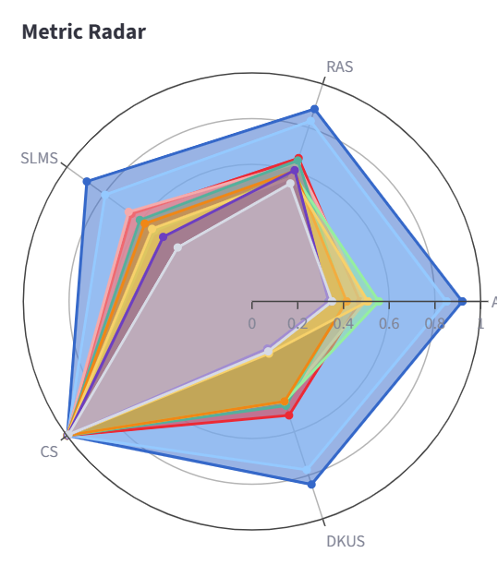
Results and Experiments
Experiment Setup
Model Performance Profile
Evaluated high-tier APIs (GPT-4o, Claude 3.5) vs. Open-Source (Llama 3.2, Qwen 2.5).
•
Dataset: 50–100 hard reasoning problems with golden references.
•
Key Findings
Rashomon Effect Confirmed: High answer accuracy (AAS) does not guarantee reasoning alignment (RAS).
•
Larger models show significantly higher consistency (CS) and step-level coverage (SLMS).
•
Notes:
To truly understand model performance, we need powerful visualizations that go beyond simple accuracy metrics. These visualizations reveal the nuances of model behavior and help us identify critical insights. Radar charts provide a unique metric profile for each model, highlighting its strengths across various dimensions. Box plots visualize score distribution, exposing model volatility and reasoning inconsistency, which is vital for high-stakes applications. The head-to-head delta offers a direct comparison between two models, pinpointing specific 'Rashomon moments' where reasoning diverges despite similar answers. This deep visual analysis prepares us for a closer look at individual reasoning paths.

Slide 9
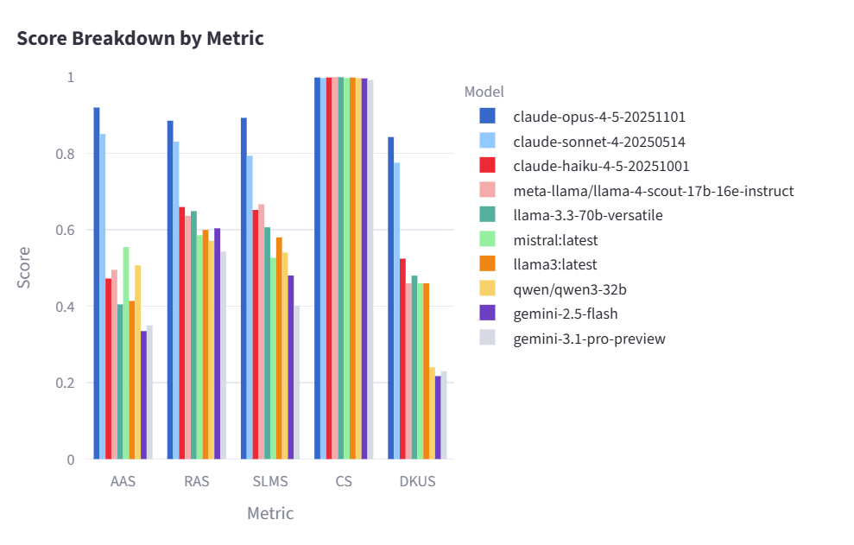
Results and Experiments
Model Performance Profile
Notes:
To truly understand model performance, we need powerful visualizations that go beyond simple accuracy metrics. These visualizations reveal the nuances of model behavior and help us identify critical insights. Radar charts provide a unique metric profile for each model, highlighting its strengths across various dimensions. Box plots visualize score distribution, exposing model volatility and reasoning inconsistency, which is vital for high-stakes applications. The head-to-head delta offers a direct comparison between two models, pinpointing specific 'Rashomon moments' where reasoning diverges despite similar answers. This deep visual analysis prepares us for a closer look at individual reasoning paths.

Slide 10
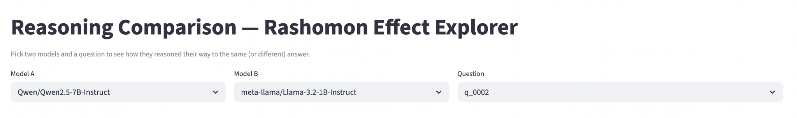
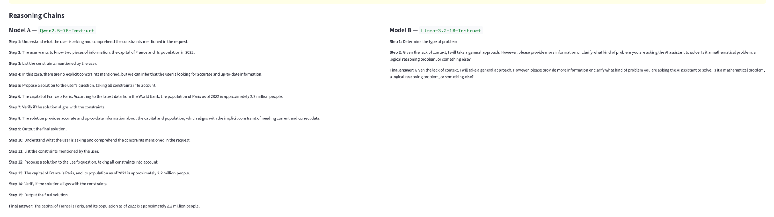
Deep-Dive: Reasoning Comparison Tool
Notes:
So this is our reasoning comparison tool, which is basically the core interactive part of the project.
You can select any two models from the dropdown, and then pick a specific question. Once you do that, the system shows the full reasoning for both models side by side.
What’s important here is that we’re not just looking at the final answer — we’re actually breaking down how each model is thinking step by step.
You also have access to the golden reference reasoning, so you can compare both models against what the correct logical path should look like.
This makes it very easy to spot cases where two models give the same answer, but one of them is clearly reasoning in a weaker or less structured way. That’s exactly the kind of behavior we’re trying to capture.

Slide 11
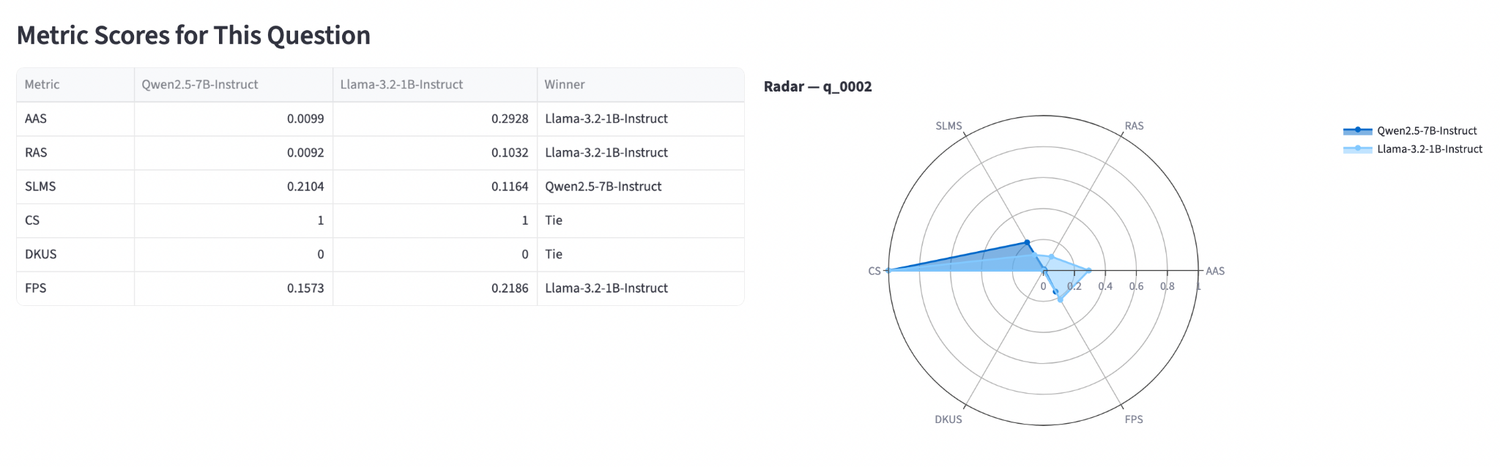
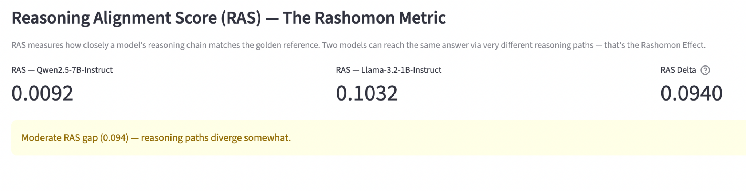
Deep-Dive: Reasoning Comparison Tool

Slide 12
Limitations and Future Work
Limitations
Future Work
Dependency on high-quality "golden" reasoning references.
•
Expanding to multi-modal reasoning (Vision + Text).
•
Embedding-based comparison may miss extremely subtle logical nuances.
•
Developing "self-correcting" reasoning loops based on SLMS feedback.
•
Computational overhead for large-scale consistency testing.
•
Scaling to more diverse, niche technical domains.
•
Notes:
While our framework offers significant advancements, it's important to acknowledge its current limitations. Our dependency on high-quality 'golden' reasoning references means the framework's effectiveness is tied to the quality of these benchmarks. Also, while embedding-based comparisons are powerful, they might occasionally miss extremely subtle logical nuances. Finally, there's a computational overhead for large-scale consistency testing, which we're actively working to optimize. Looking ahead, we're excited to expand this framework to multi-modal reasoning, incorporating vision and text. We also plan to develop 'self-correcting' reasoning loops based on SLMS feedback, and scale our approach to even more diverse and niche technical domains. This continuous evolution will further strengthen our ability to evaluate and build truly trustworthy AI.

Slide 13
Conclusion and Key Takeaways
What We Built
Why It Matters
Framework evaluating reasoning quality vs. accuracy.
✓
Exposes the Rashomon Effect: same answer ≠ same reasoning.
✓
Five interpretable, non-black-box metrics.
✓
Critical for high-stakes domains (medical, legal, engineering).
✓
Interactive dashboards for reasoning comparison.
✓
Enables trustworthy AI with verifiable logic.
Pluggable support for APIs and open models.
✓
✓
Actionable insights via configurable metric weights.
✓
"Would you trust a model that got the right answer via flawed reasoning?"
Notes:
In conclusion, we've developed a robust framework that goes beyond mere accuracy to evaluate the quality of AI reasoning. This framework is critical for building trustworthy AI, especially in high-stakes domains. We've built a system with five interpretable metrics and interactive dashboards for detailed reasoning comparison, supporting both API and open-source models. This work exposes the 'Rashomon Effect,' demonstrating that identical answers don't always mean identical, or equally sound, reasoning. This is paramount for fields like medicine, law, and engineering, where verifiable logic is non-negotiable. Our goal is to provide actionable insights, ensuring that we trust not just the answer, but the path taken to get there. As the question asks, 'Would you trust a model that got the right answer via flawed reasoning?'

Slide 14

Thank You
QUESTIONS?

Slide 15

Team Contributions
Member
Contributions
Varun
Pranika
Mihir

Slide 16
How to Read Each Score
Plain-language guide for an evaluator picking a model
Metric — question it answers
What a high value means (≥ 0.7)
Most telling for
AAS — "Did it land on the right answer?"
Same answer as golden, perhaps reworded
Chatbots, search summaries, lookups
RAS — "Did it think about it the same way?"
Reasoning chain matches in argument structure
High-stakes domains (medical, legal); auditability
SLMS — "Did it walk through every required step?"
Touched every golden step (asymmetric)
Safety-critical reasoning; no skipped steps
CS — "Does it tell the same story twice?"
Stable reasoning across repeated runs
Agentic loops; pipelines that re-query
DKUS — "Does it use the domain vocabulary?"
Uses the required technical terms
Specialist domains (finance, biomedicine, security)
FPS — "What do I look at first?"
High composite — strong starting recommendation
Leaderboard view; always drill into components
Decision shortcut
• High FPS + high RAS + high SLMS → recommend with confidence
• High AAS but low RAS / SLMS → classic Rashomon case; right today, brittle tomorrow
• High everything except CS → fine for one-shot use, risky in agentic loops
• High everything except DKUS → fine for general reasoning, suspect in specialist domains

Slide 17
FPS Weight Justification
Why each metric carries the weight it does — and why the ranking is robust
Weight
Justification
w_RAS = 0.30 (highest)
Full-chain alignment is the most direct test of "did it reason like the golden answer." Captures the Rashomon Effect head-on.
w_SLMS = 0.25
Forces the model to walk through each required step, not just produce a chain that aggregates to a similar embedding.
w_AAS = 0.20
Answer correctness still matters but every other benchmark already optimises for it. Two equal-AAS models can have very different reasoning quality.
w_DKUS = 0.15
Domain vocabulary check. Implementation is substring-based, so synonyms score zero — kept lower until LLM-judge variant lands.
w_CS = 0.10 (lowest)
At temperature 0.7 every model scored CS ≥ 0.99 — does not discriminate well in this dataset. Kept as a tie-breaker.
Sensitivity to weight choice — rankings are stable
Default / Equal / Reasoning-only schemes
claude-haiku-4-5, claude-sonnet-4, claude-opus-4-5 (mistral → 4)
AAS-heavy (w_AAS = 0.50)
claude-sonnet-4, mistral, claude-haiku-4-5 (mistral → 2)
AAS-only (w_AAS = 1.00, the failure mode)
mistral, claude-sonnet-4, claude-opus-4-5 (mistral → 1)

Slide 18
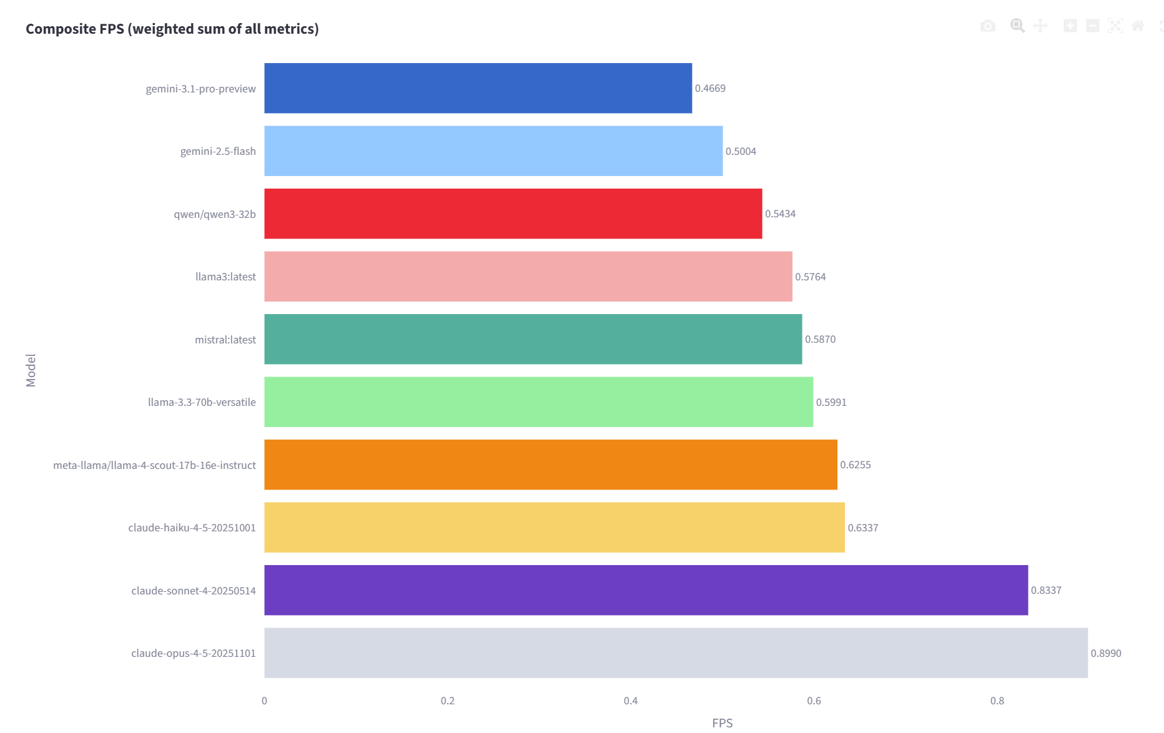
Additional Results

Slide 19
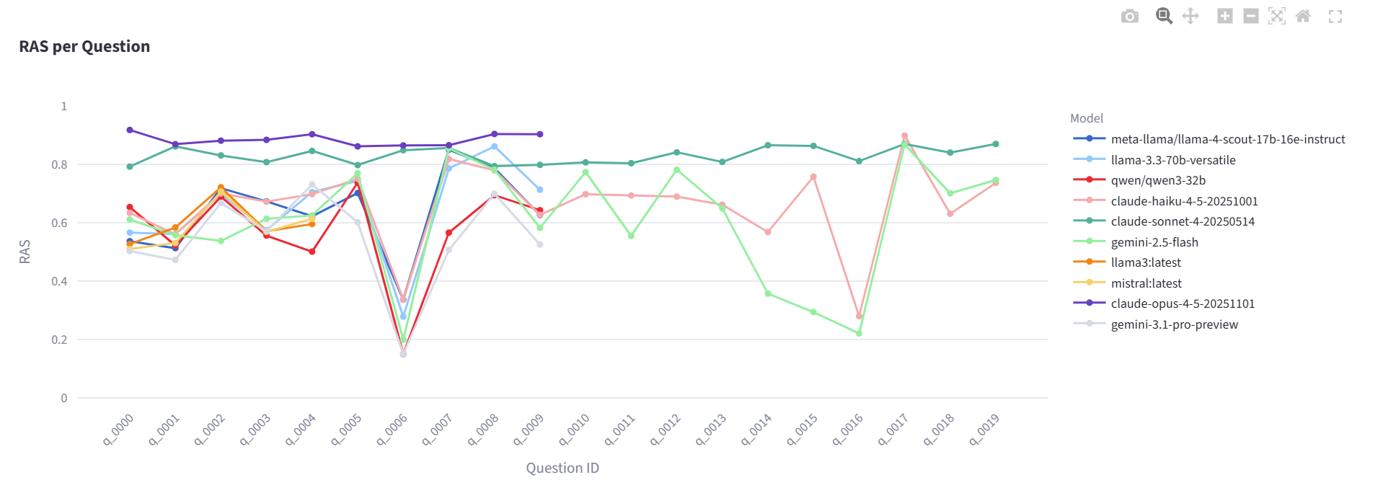
Additional Results

Slide 20
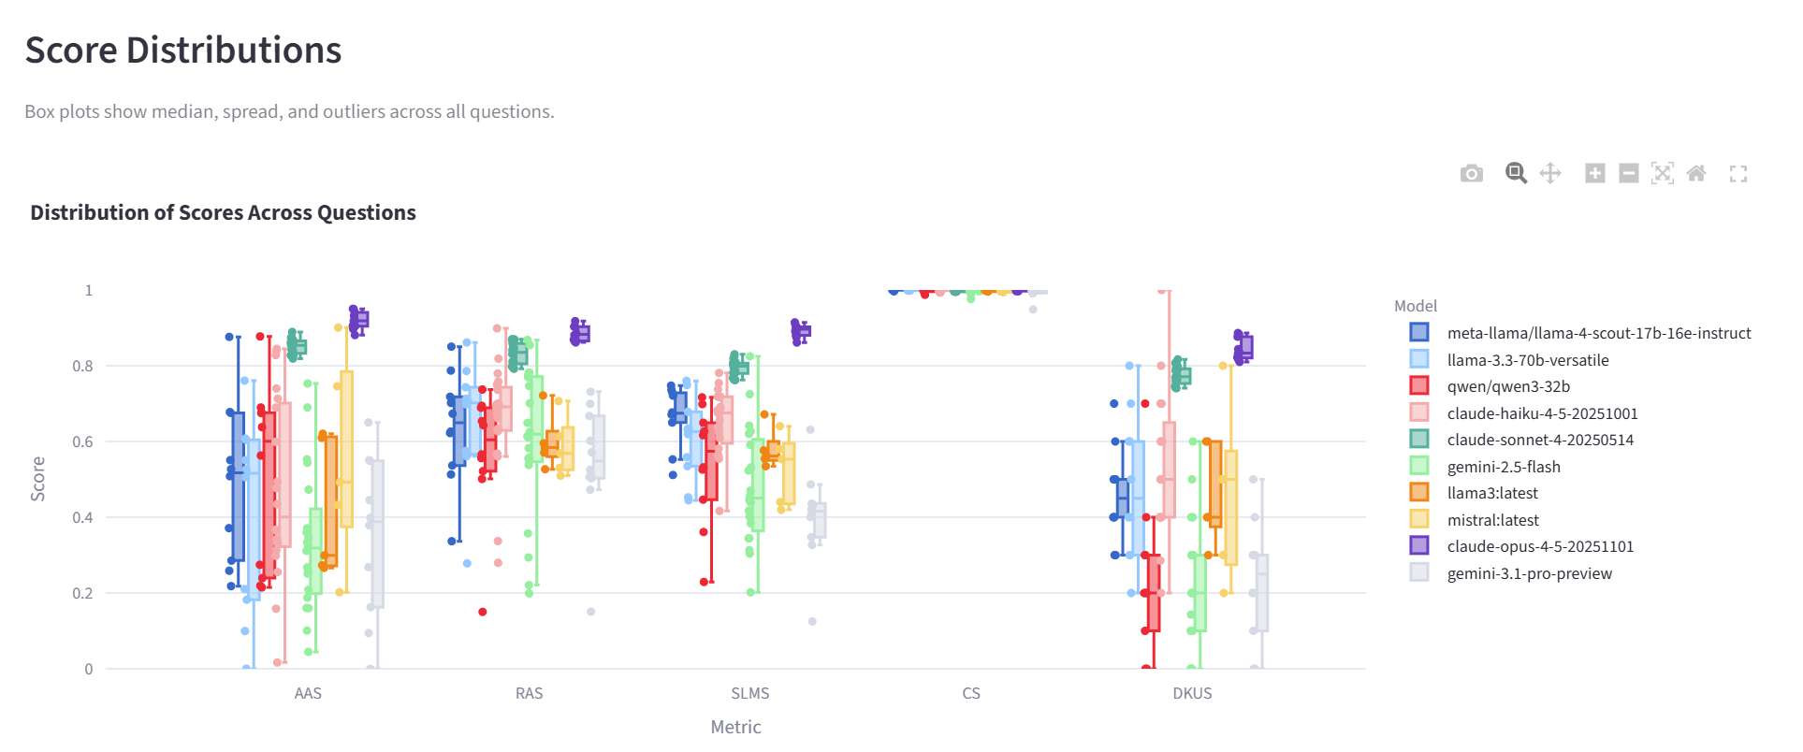
Additional Results

Slide 21
Project Repository
GITHUB REPOSITORY
https://github.com/mihir965/roshomon_effect_project/

